Slide 1
Exploring Register File Size and
Memory Configurations in ASIP Synthesis
Presenter Manoj Kumar Jain 1999RCS002
Supervisors
M. Balakrishnan Anshul Kumar

Slide 2
Overview
Introduction
Approaches in ASIP Synthesis
Reg. File and Memory Exploration
Proposed Methodology
Approach to be followed and Status

Slide 3
Application Specific
Instruction Set Processors
Designed for specific application
Exploits special characteristics to meet the desired constraints
Efficient for applications like digital signal processing, automatic control systems, cellular phones

Slide 4
GPP-ASIP-ASIC
 | GPP | ASIP | ASIC
Performance | Low | High | Very High
Flexibility | Excellent | Good | Poor
HW Design Effort | Nil | Large | Very Large
SW Design Effort | Small | Large | Nil
Power | Large | Medium | Small
Reuse | Excellent | Good | Poor
Markets | Very Large | Relatively large | Small
Cost | Mainly on SW | S-O-C | Volume sensitive

Slide 5

Flow Diagram of a typical
ASIP Design Methodology
Application &
Design Constraints
Application Analysis
Architectural Design Space Exploration
Instruction Set
Generation
Code Synthesis
Hardware Synthesis
Object Code
Processor Description

Slide 6
Approaches in ASIP Synthesis
Simulator based
Analytical (Scheduler based)

Slide 7
Simulator based
Application
(HLL)
Retargetable
Compiler
Object
Code
Simulator
Architecture
Description
Trace Data

Slide 8
Analytical (Scheduler based)
Architecture
Description
Application
(HLL)
Profiler
Retargetable
Estimator
Performance and
other Estimates

Slide 9
Simulator based v/s Analytical
Simulator based approach needs an efficient retargetable compiler and simulator
Analytical approach does not need assembly code generation
Simulator based approach is slower
Simulator based approach produce more correct results
Limited architectural features explored by analytical approaches

Slide 10
Which approach is more desirable ?
Increasing dimensions of design space
Design space exploration needs to be very fast
Storage organization to be explored by analytical approach

Slide 11
Register File Size and Memory Conf. Exploration by Simulator based Approaches
Register banks I/D-Cache [Gloria90, Gong95, Kin99]
Attempt to optimize register count based on profiler information but method needs code generation and analysis [Honma94]
Language based approach [Mishra2001]

Slide 12
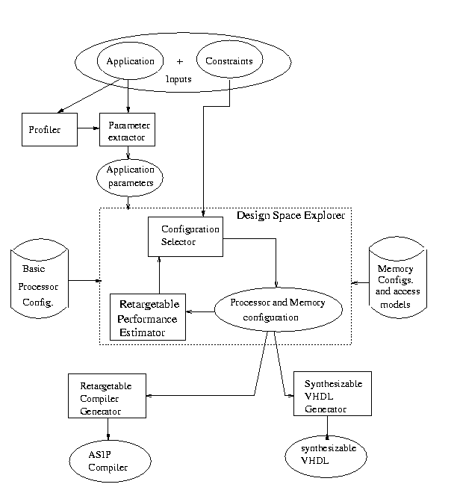
Flow diagram of overall Methodology

Slide 13
Study the Influence of Register File Size on Power and Performance
Compiler frame work
ARM7TDMI processor
Instruction memory off-chip/ on-chip
Power model based on Tiwari’s power model
Number of Registers 3 to 8
Results for code size, performance, power and energy consumptions taken

Slide 14
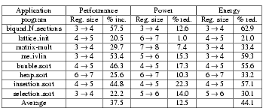
Maximum variation in results

Slide 15
Approach to be followed
Profile application to get execution count for each basic block
Get base performance using Gupta’s list scheduler with unlimited register file size
Estimate the over head due to limit on number of registers
Add overheads in base execution time to get overall execution time

Slide 16
Overhead Estimation
Borrow concept of Register Reuse Chain (RRC) given by Zhang for register allocation
RRC’s are merged and additional dependencies are generated (as per Zhang approach)
Performance overhead due to these additional dependencies to be estimated (our contribution)
Spilling to be considered if required and overhead to be estimated (our contribution)
Implementation to be done

Slide 17
Using RRCs for Register Allocation
A RRC contain all the variables assigned to the same register
Initial RRCs contains the variables whose longest live range do not overlap
Conflict graph is generated chain[i] chain[j] chain[i] cannot reuse the register assigned to chain[j]
Graph-coloring over conflict graph

Slide 18
An Example
Prog. data dep.
Additional dep.
a
a=1;
b=a+1;
c=2*b;
d=b/2;
e=b-1;
f=c+d+e;
g=3*f
C Code
R1 R2 R3
a d e
b
c
f
g
b
c
d
e
f
g
Correct Order (1) (2) (4) (5) (3) (6) (7)
Incorrect Order (1) (2) (3) (4) (5) (6) (7)

Slide 19
Example cont.
a
Variable EUK
a b
b f
c f
d f
e f
f g
a=1;
b=a+1;
c=2*b;
d=b/2;
e=b-1;
f=c+d+e;
g=3*f
C Code
b
c
d
e
f
g
Earliest Ultimate Killing (EUK) Node is the earliest node where
Variable’s live range is guaranteed to end

Slide 20
Example cont.
Basic Idea : Recursively search the EUK nodes
and assign the same register.
RRC1 a b f g
RRC2 c
RRC3 d
RRC4 e
RRC2
RRC1
RRC3
RRC2
RRC4
RRC1
RRC3
Conflict Graph
RRC4
Undirected C.G. and Graph Coloring

Slide 21
Memory Configurations exploration
We are in the process of finding suitable strategy to explore memory configuration - presence of cache - instruction/ data cache sizes - on-chip/ off-chip instruction memory - write policies etc
Once we design strategy for it we will implement it

Slide 22
Thanks

